Slide 1
WIDERA
Widening participation and
Strengthening the European Research Area (ERA)
DANIELE GIZZI
15 May 2025
YEREVAN – ARMENIA

Slide 2
HORIZON EUROPE
EURATOM
Specific Programme: European Defence Fund
Specific Programme implementing Horizon Europe & EIT*
Exclusive focus on civil applications
Fusion
Pillar I
Excellent Science
Pillar II
Global Challenges & European Industrial Competitiveness
Pillar III
Innovative Europe
Exclusive focus on defence research & development
European Research Council
Health
Culture, Creativity & Inclusive Society
Civil Security for Society
Digital, Industry & Space
Climate, Energy & Mobility
Food, Bioeconomy, Natural Resources, Agriculture & Environment
European Innovation Council
Fission
Research actions
Marie Skłodowska-Curie
Clusters
European Innovation Ecosystems
Research Infrastructures
European Institute of Innovation & Technology*
Development actions
Joint Research Centre
Joint Research Center
Widening Participation and Strengthening the European Research Area
Widening participation & spreading excellence
Reforming & Enhancing the European R&I system
* The European Institute of Innovation & Technology (EIT) is not part of the Specific Programme

Slide 3
Horizon Europe Budget: €95.5 billion (2021-2027)
(including €5.4 billion from NGEU – Next Generation Europe – programme of EU for Recovery from COVID-19 crisis)
Political agreement December 2020
€ billion in current prices

Slide 4
Widening participation and strengthening the European Research Area Infoday videos: https://www.youtube.com/watch?v=wdK-P91UtSo https://www.youtube.com/watch?v=rbuDOB_oukQ
HORIZON EUROPE

Slide 5
Widening Participation & Strengthening the European Research Area (ERA)
Objective:
Increase support to EU Member States and AC in their efforts to make the most of their national research and innovation potential and promote an ERA where researchers, scientific knowledge and technology circulate freely
Two components:
Widening Participation and Spreading Excellence
Destination 1: Improved access to excellence
Destination 2: Attracting and mobilising the best talents
Reforming and enhancing the EU R&I system
Destination 3: Reforming and enhancing the EU R&I system
One work programme, consisting of 3 destinations

Slide 6
Widening Participation & Strengthening the European Research Area (ERA):
Widening Participation and Spreading Excellence
Teaming, Twinning, ERA Chairs,
European Cooperation in Science and Technology (COST)
Boosting National Contact Points‘ (NCPs) activities, pre-proposal checks and advice
Brain circulation
Excellence initiatives:
Possibility for entities from widening countries to join already selected collaborative R&I actions
Recognition of participation
Matchmaking services
Reforming and enhancing the EU R&I system
Strengthening the evidence base for R&I policy
Foresight
Support for policy makers to the ERA development
Support to national R&I policy reform, including Policy Support Facility
Attractive researcher careers and links with higher education
Open science, citizen science and science communication
Gender equality
Ethics and integrity
Support to international cooperation
Scientific input to other policies
Support to the Programme implementation
Support for National Contact Points
Support to dissemination & exploitation
€2.96 billion
€0.44 billion
Notes:
Hard to read online, too much information. Suggest to split this in two slides

Slide 7
Widening Participation and Spreading Excellence

Slide 8
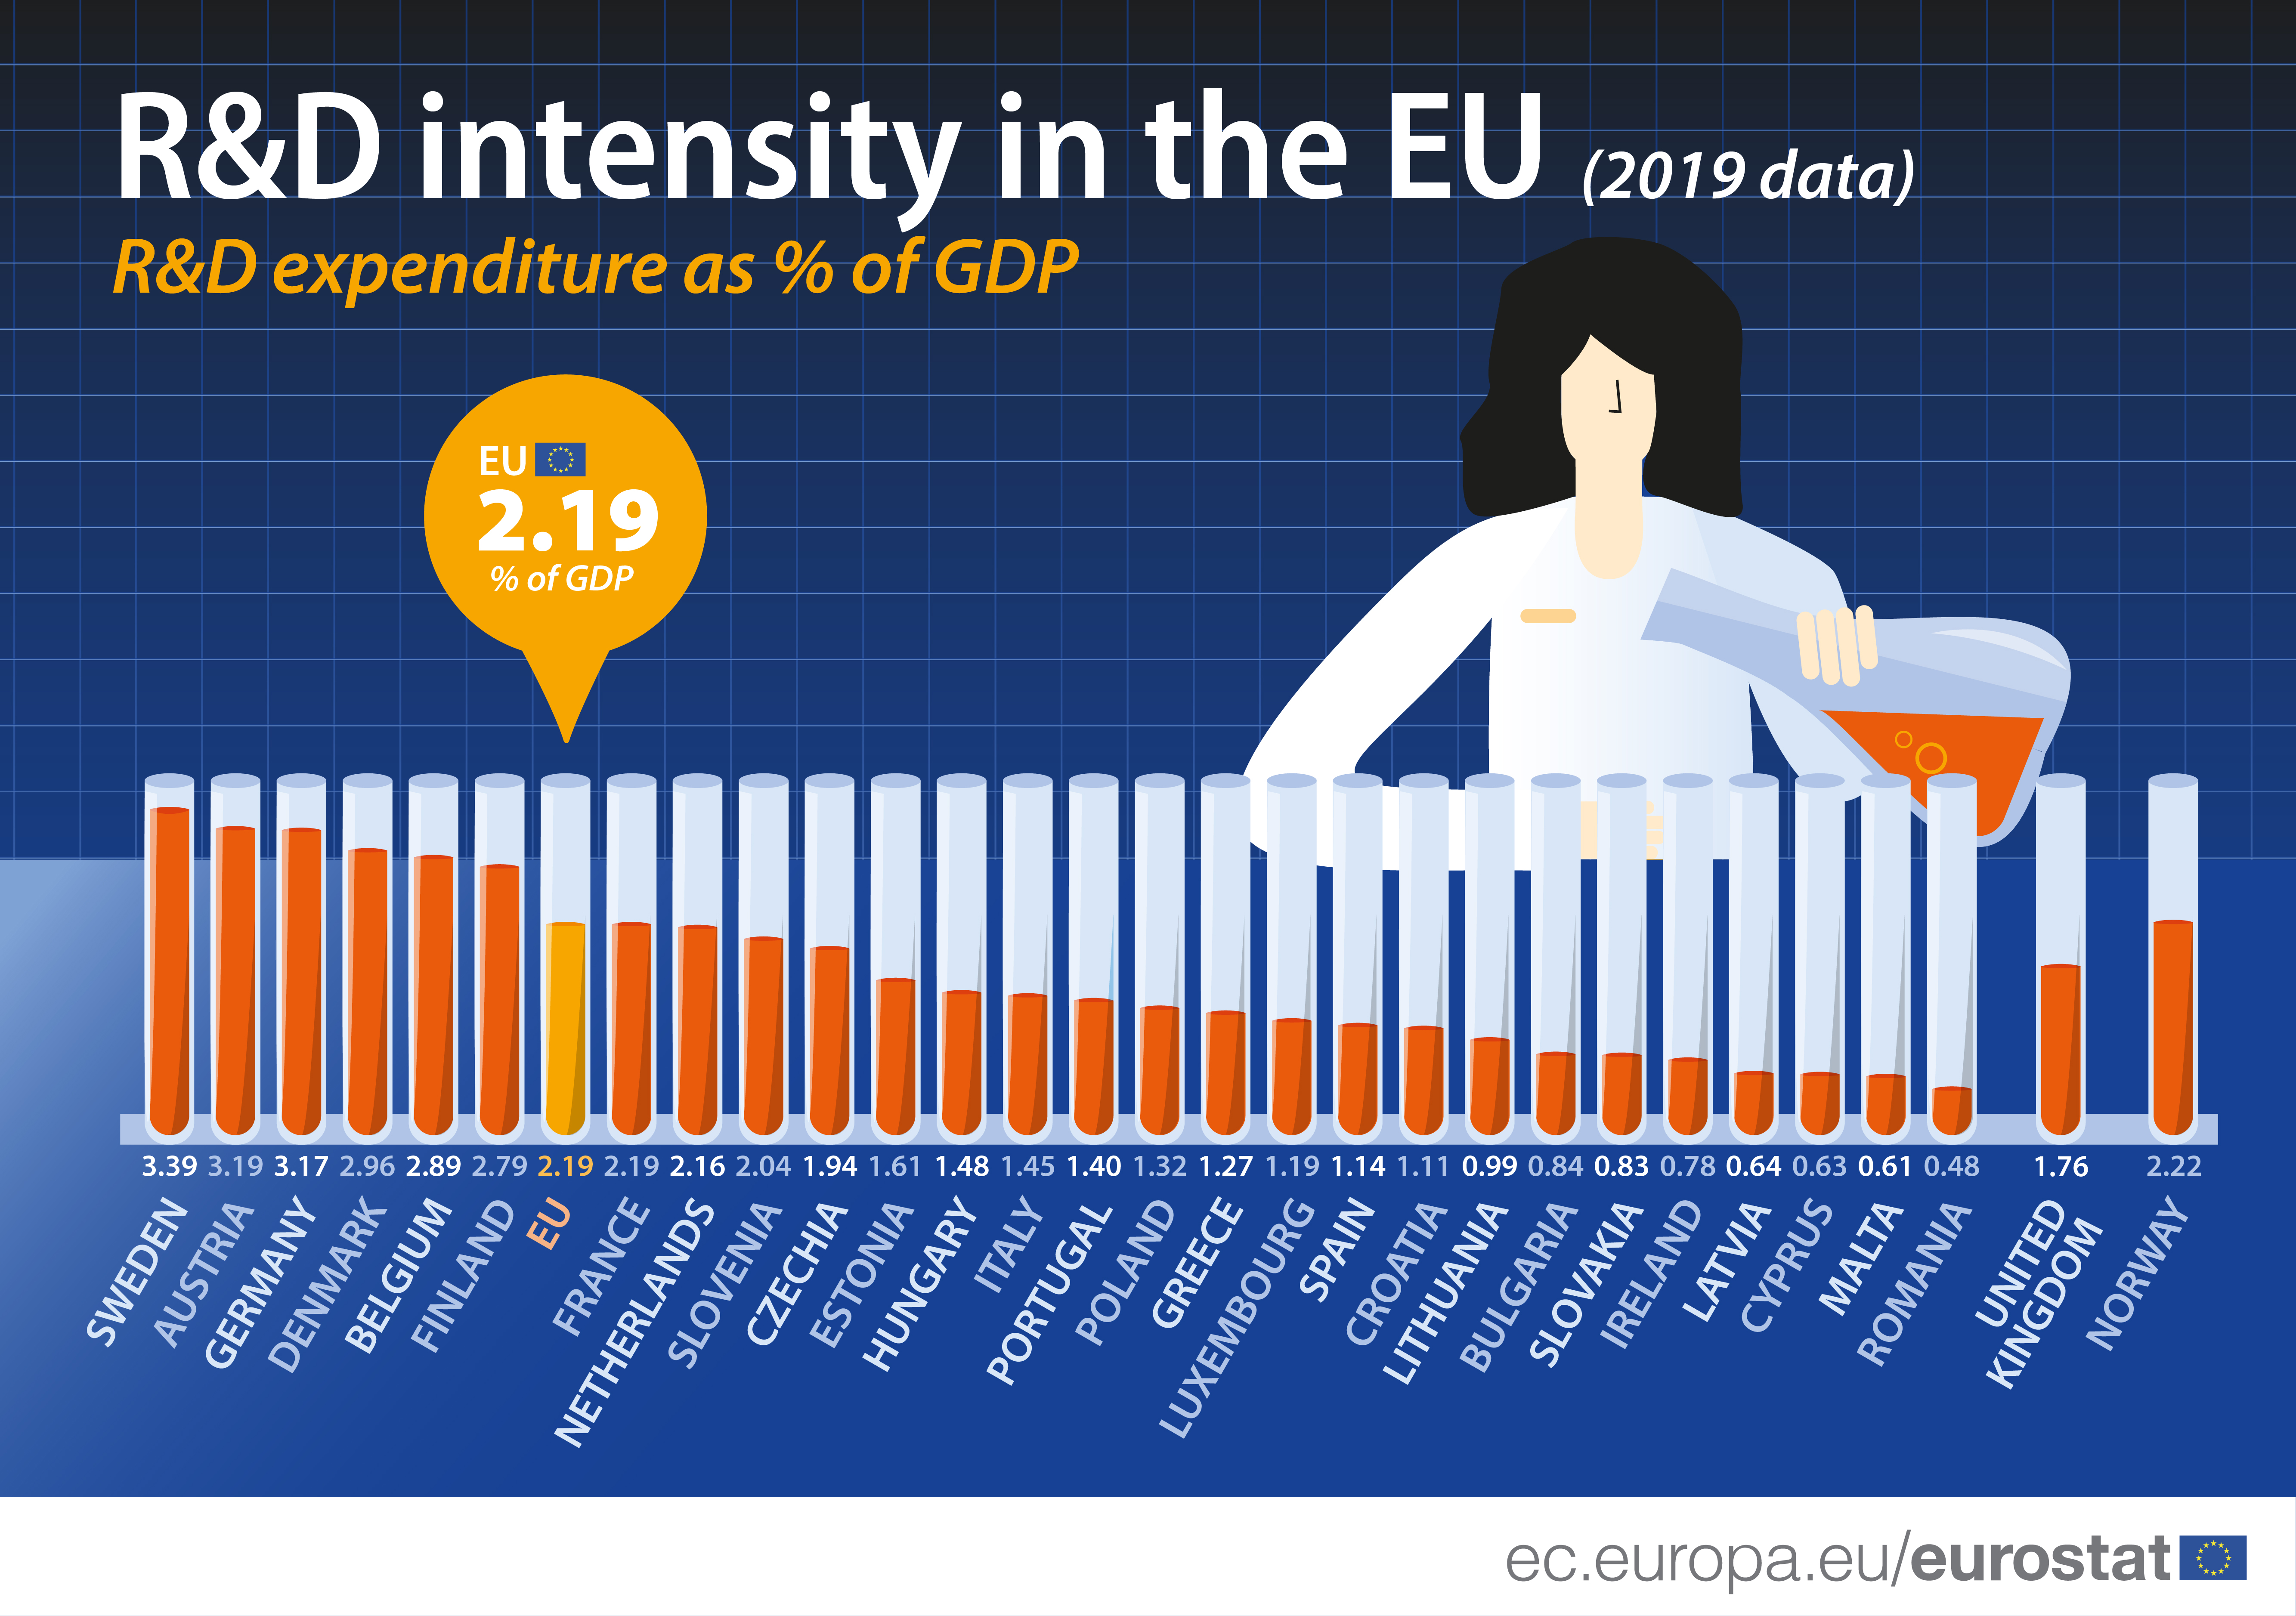
R&I Intensity (3%-Goal, GERD)
Change in the past 10 years
Belgium
Poland
Czech Republic
19
6
Finland
Ireland
2
France, Sweden

Slide 9
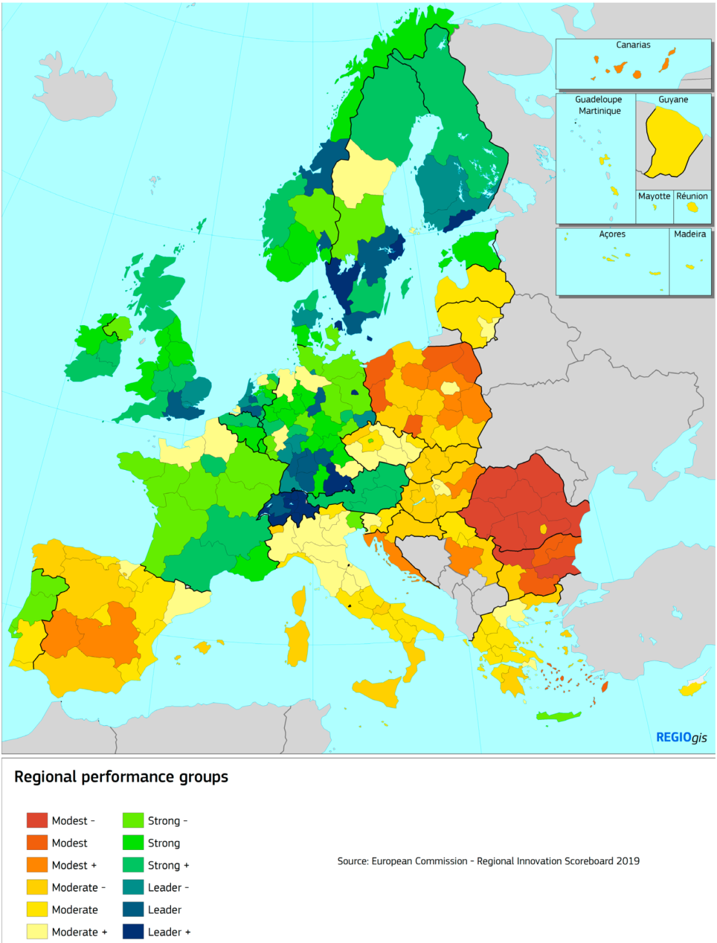
Research and innovation gap
Large differences in scientific and innovation performance in Europe
Efficient national R&I systems >>> leads to economic development, competitiveness, employment
Target countries for the programme: The countries with less advanced R&I systems, as compared to leading countries in the EU
Notes:
Poor performance does not sound nice. In the draft WP they use „less advanced“

Slide 10
Applicants / Coordinators
Eligible Coordinators
EU13
Eligible Countries
EU Member States (EU14) + Associated Countries to HEU; still being negotiated
Notes:
Replaced Associated States with Associated Countries – terminology that is used for associated.

Slide 11
Overview: Widening in Horizon Europe
Budget 800 m. EUR (H2020) 2,95 bn. EUR (HEU)
Advancing Europe Package (Council of the European Union)
Admission of additional partners from the Widening countries to existing projects (pillar 2)
Reinforcement of matchmaking services in the search for project partners
External pre-proposal checks for EU13
Comprehensive evaluation of the funded projects (network analyses etc.)

Slide 12
This part of the Horizon Europe Work Programme 2025 addresses the area “Widening participation and strengthening the European Research Area” (WIDERA).
The work programme includes two components:
I: Widening participation and spreading excellence;
II: Strengthening the European Research Area (ERA) by reforming and enhancing the European research and innovation system.

Slide 13
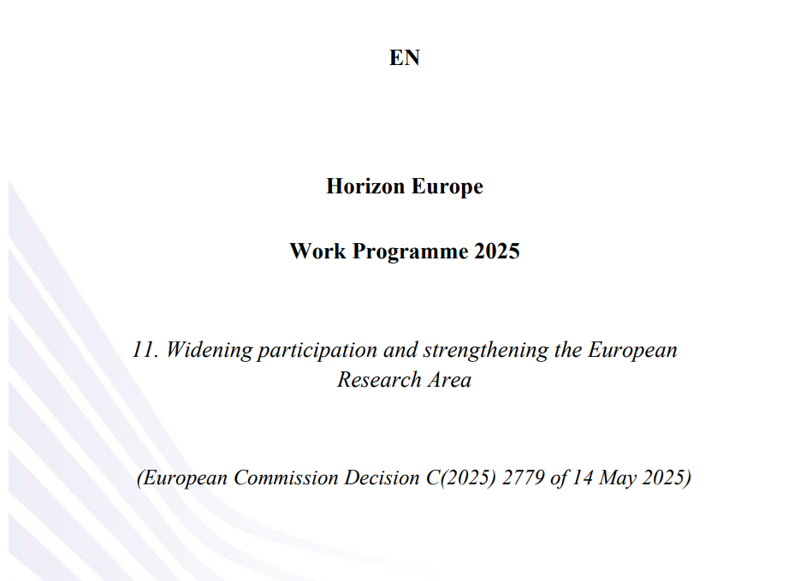
CALLS PUBLISHED ON 14 MAY 2025

Slide 14
CALLS PUBLISHED ON 14 MAY 2025
See in particular:
The Call European Excellence Initiative (EEI):
“The European Excellence Initiative in its widening dimension aims to raise excellence
in science and in knowledge valorisation of Europe’s universities through cooperation.”
Also (NOT for this year but maybe in Work Programme 2026-27), the TWINNING Call:
“To strengthen a specific research area of a research institution through partnerships with leading institutions in Europe”

Slide 15
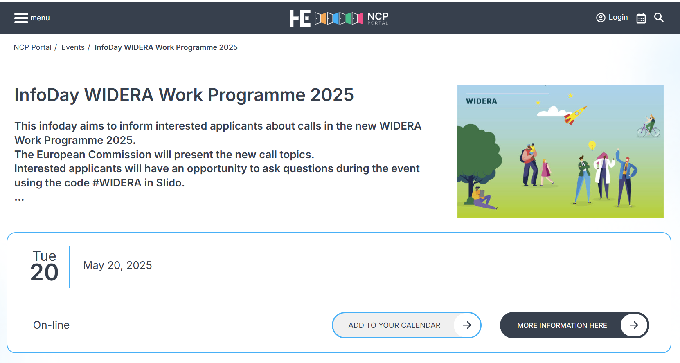
https://horizoneuropencpportal.eu/stage/infoday-widera-work-programme-2025

Slide 16
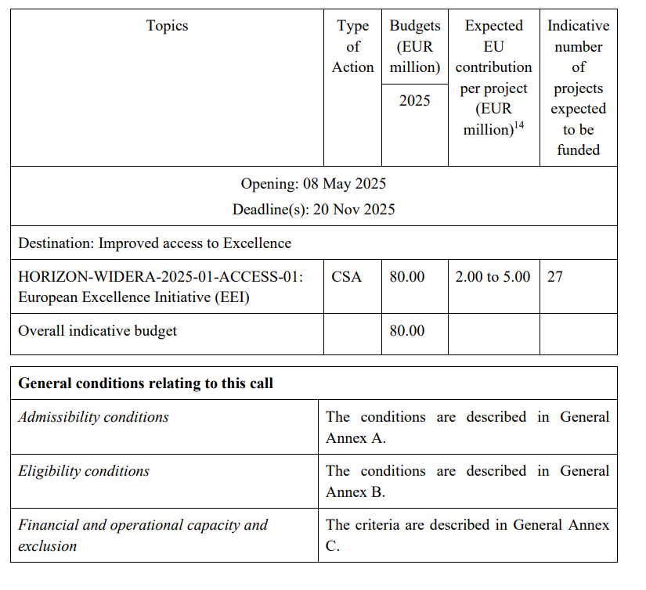

Slide 17
Thank you!
# HorizonEU
http://ec.europa.eu/horizon-europe

